Slide 1
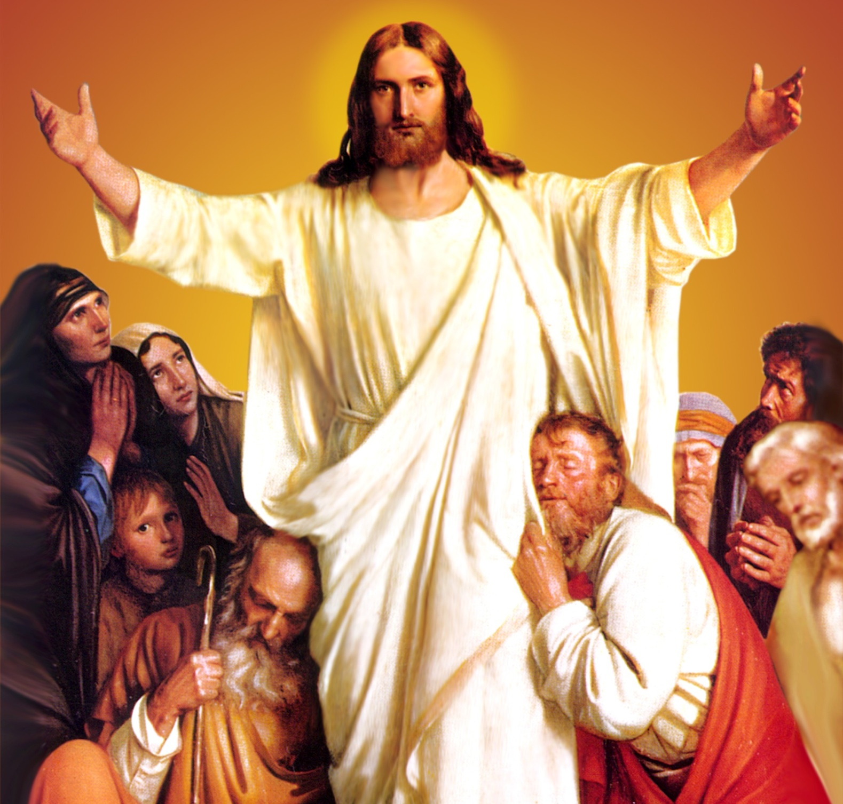
CATECHETICAL TEXTBOOK SERIES OF THE SYRO - MALABAR CHURCH
ON THE PATH OF SALVATION - 6
PEOPLE WHO
EXPERIENCED JESUS
6

Slide 2
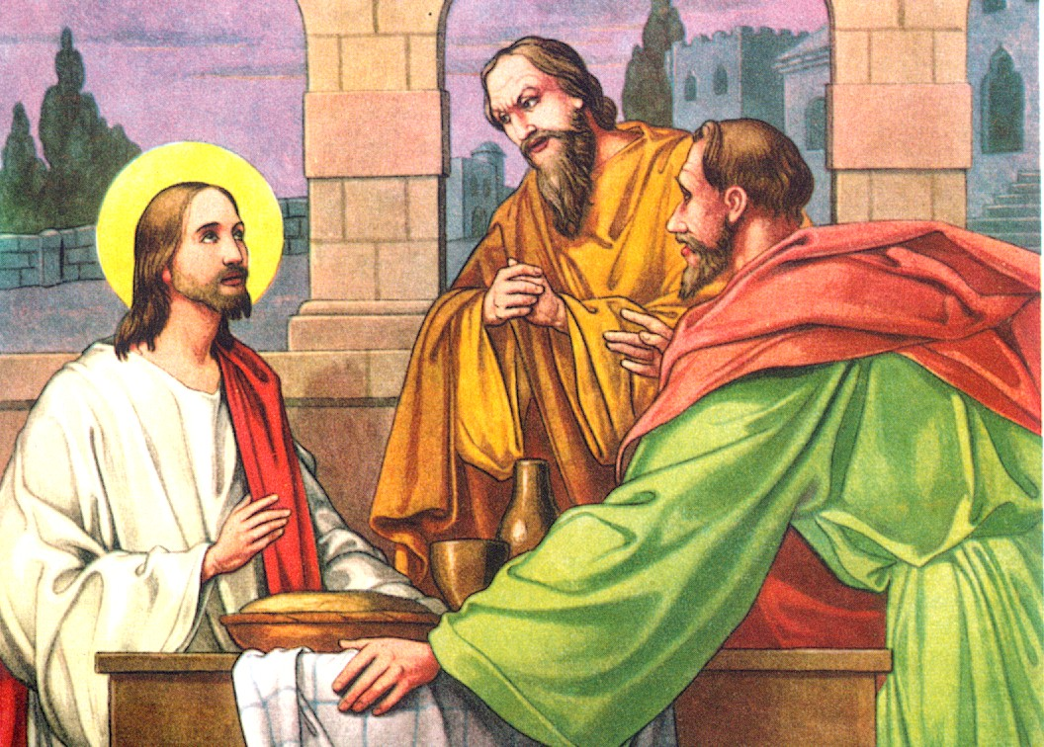
LESSON 11
THE EMMAUS EXPERIENCE

Slide 3
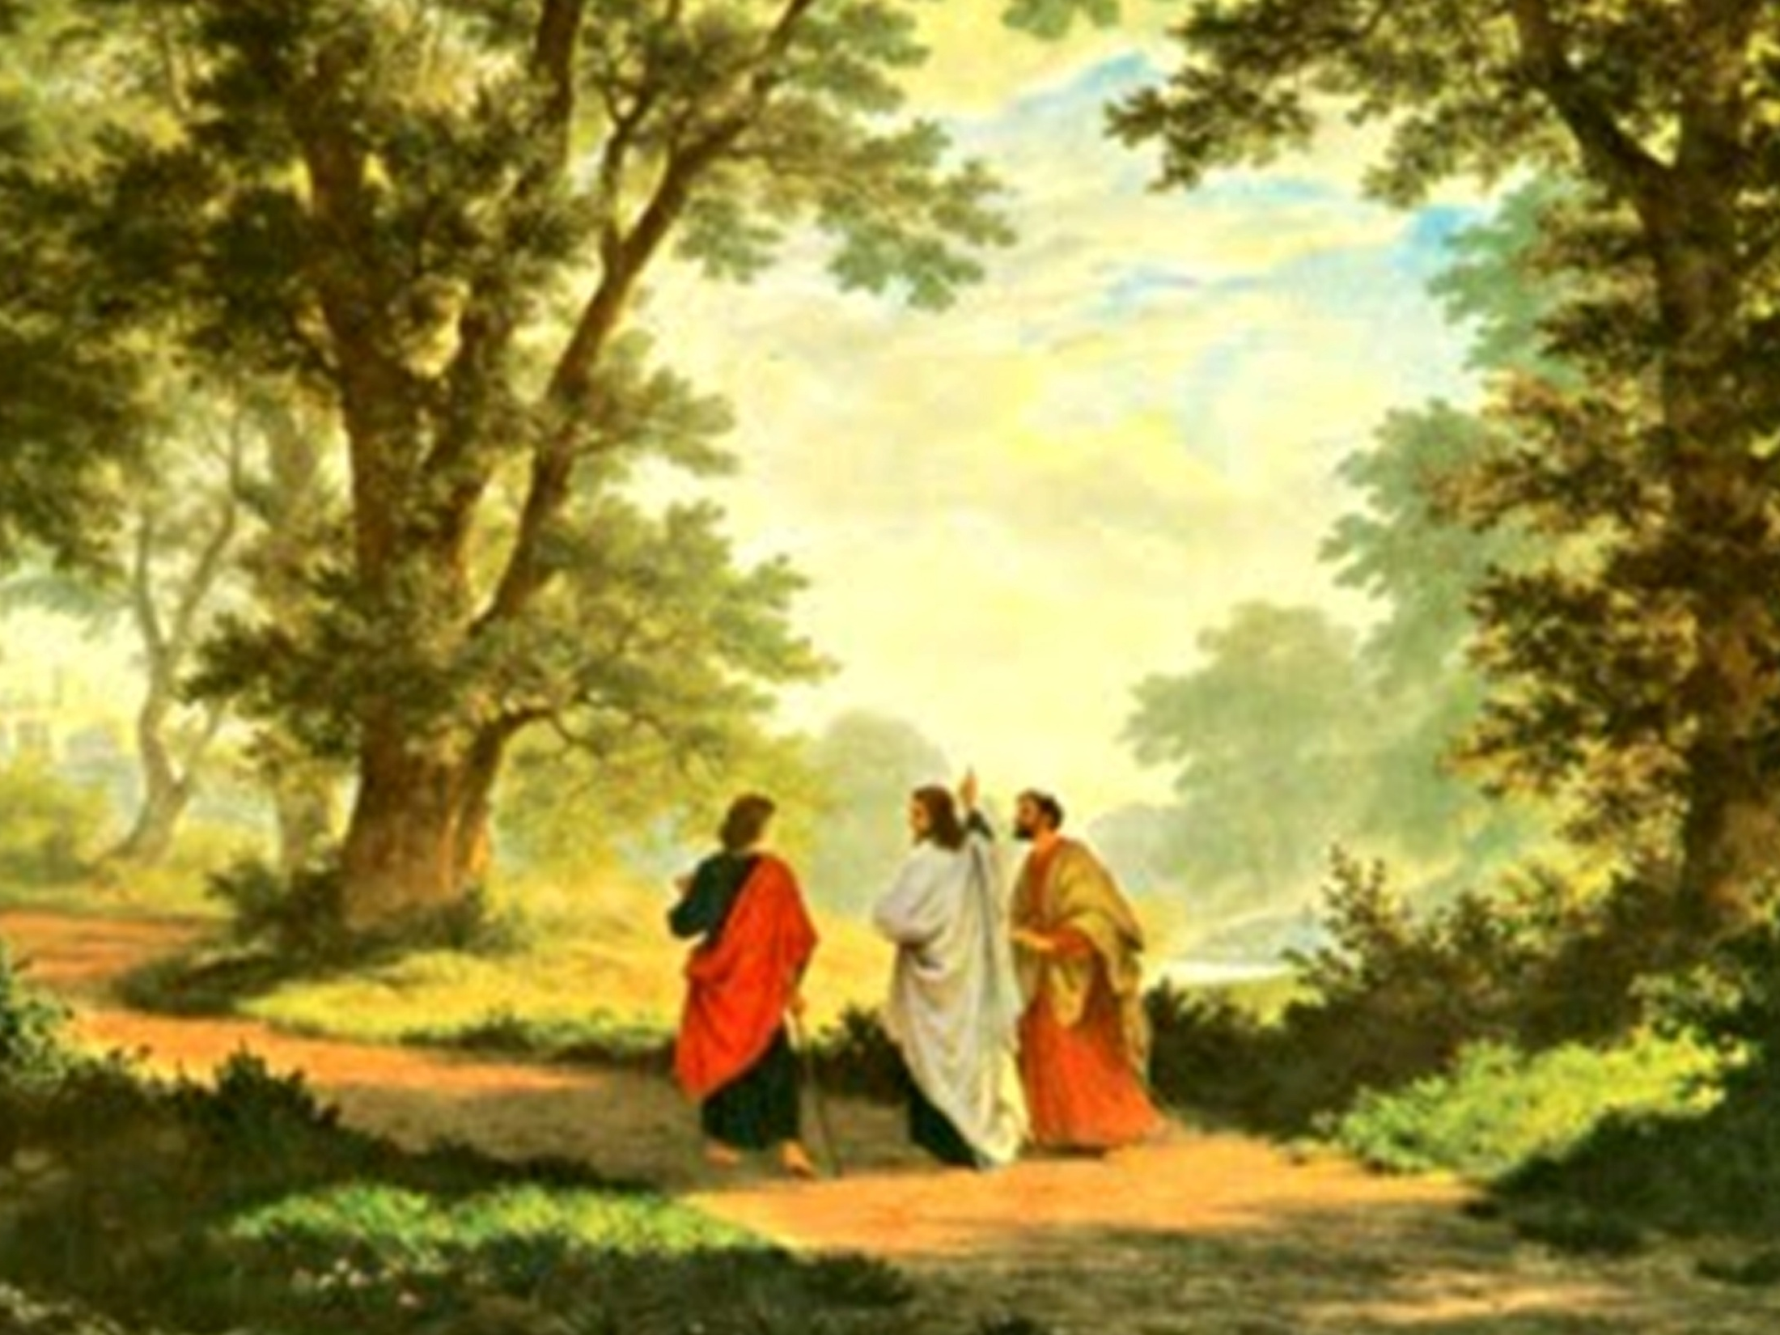

Slide 4
Two of Jesus' disciples were going to the village of Emmaus, about 60 stadion (roughly 10 km) from Jerusalem. They were discussing the passion, crucifixion and resurrection of Jesus. They looked dejected and full of disappointment and Jesus joined them like a stranger. He asked them, “What is it that you are talking about?” One of them named Cleopas replied with a counter question, “Are you a stranger who didn't hear about what was happening in Jerusalem these days?” Again Jesus asked, “What things?” They replied, “The things about Jesus of Nazareth, who was a prophet, mighty in deed and word before God and all the people, and our chief priests and elders handed him over to be condemned to death and crucified him. But we had hoped that he was the one to redeem Israel. Yes, and besides all this, it is now the third day since these things took place. Moreover, some women of our group astounded us.

Slide 5
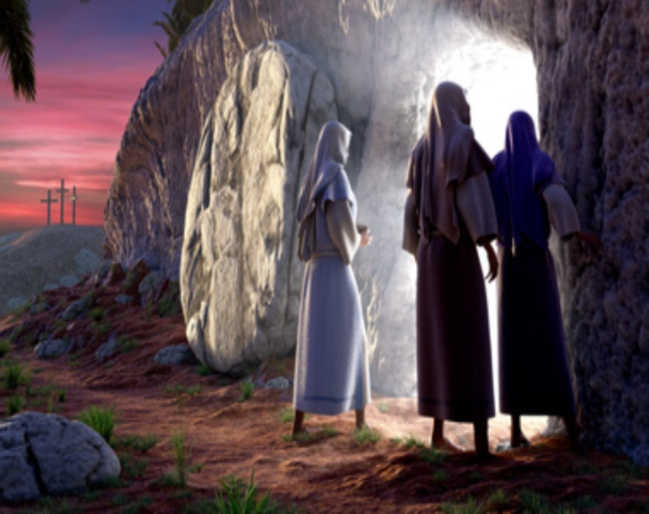
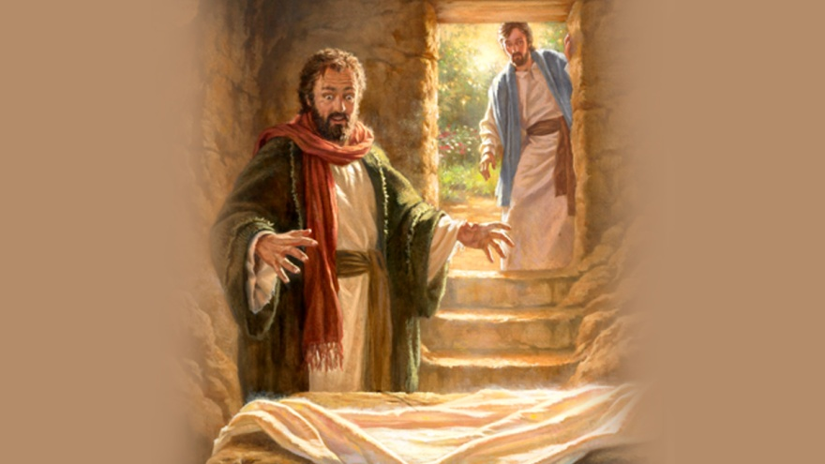
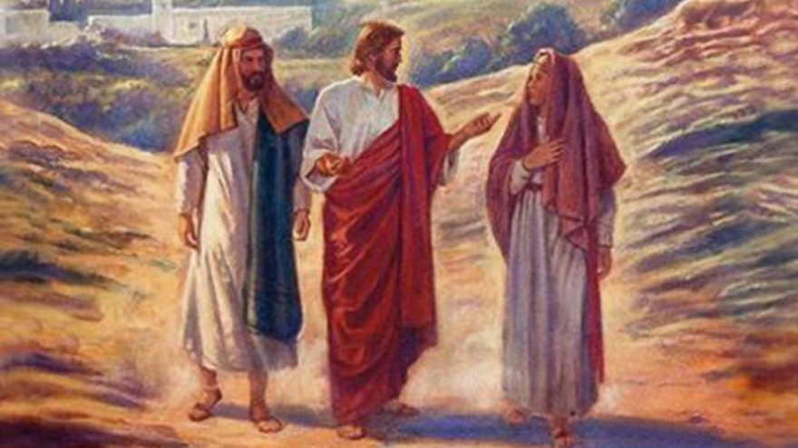
They were at the tomb early this morning, and when they did not find his body there, they came back and told us that they saw a vision of angels who said that he was alive. Some of those who were with us went to the tomb and found it just as the women had said; but they did not see him.” Then he said to them, “Oh, how foolish you are, and how slow of heart to believe all that the prophets have declared! Was it not necessary that the Messiah should suffer these things and then enter into his glory?” Then, beginning with Moses and all the prophets, he interpreted to them the things about himself in all the scriptures.

Slide 6
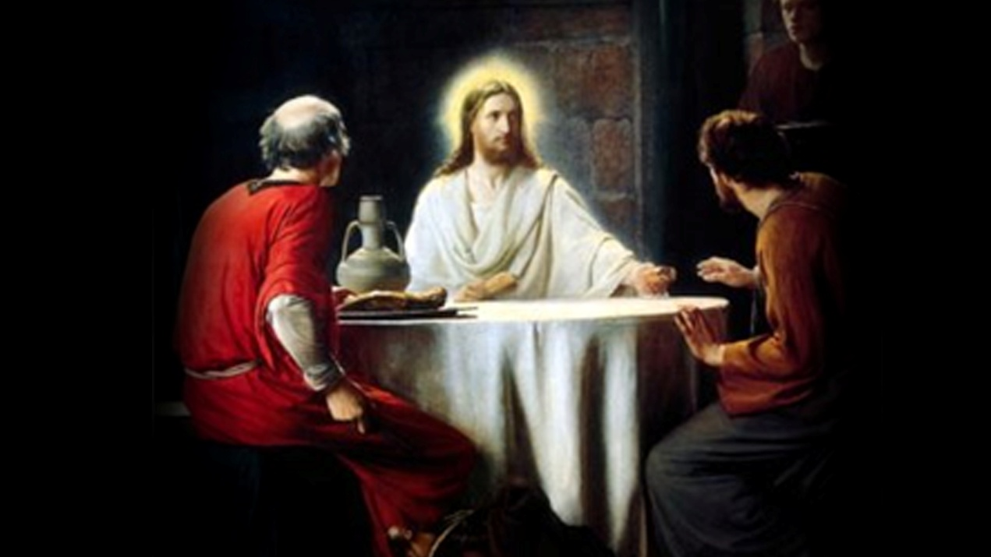
As they came near the village to which they were going, he walked ahead as if he were going on. But they urged him strongly, saying, “Stay with us, because it is almost evening and the day is now nearly over.” So he went in to stay with them. When he was at the table with them, he took the bread, blessed and broke it, And gave it to them. Then their eyes were opened and they recognized him.; and he vanished from their sight (Lk. 24: 13- 32).

Slide 7
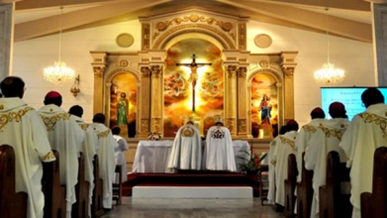
JESUS WHO INTERPRETS THE HOLY SCRIPTURES
What Jesus first shared with the dejected disciple on the way to Emmaus was the Word of God. He explained to them all that was written about him in the Holy Scriptures, starting with Moses (Lk. 24: 27). Those words kindled their hearts. The feeling of loss and disappointment that fogged their minds cleared up. Darkness was dispelled from their hearts. The words of the Old Testament, inspired by God point to the plan of salvation that was to be fulfilled through Jesus, Son of God. Through the New Testament we experience the fulfillment of this plan. Whenever we read the Word of God contemplatively, we are experiencing Jesus himself. His presence will enkindle our hearts. It is this flame that assists us in recognizing the presence of Jesus in the Holy Eucharist.

Slide 8

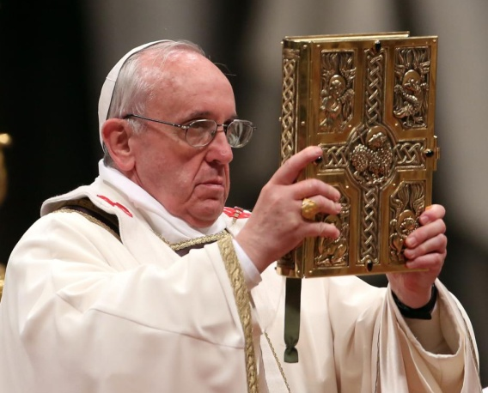
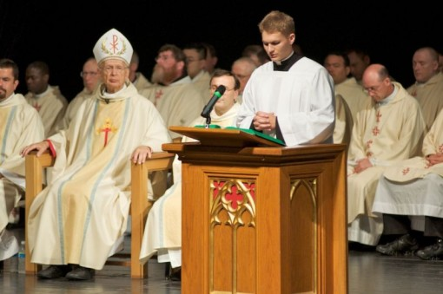
LITURGY OF THE WORD IN HOLY MASS
Liturgy of the Word is given great prominence in the Syro-Malabar Mass. In our liturgy of the Mass there is a long prayer service that prepares us to receive the Word of God that is shared at the table of the Holy Word. We prepare to listen to the Word of God at the service with the prayer: “O! Lord, enlighten our intellect to hear and understand the sweet voice of your divine and life-giving commands”. There are readings from the gospels, epistles, prophets and the laws. Thus Jesus helps us to offer the sacrifice after being sanctified by the Word of God. When the Scriptures are being read in the church it is Jesus himself who is talking to us.

Slide 9
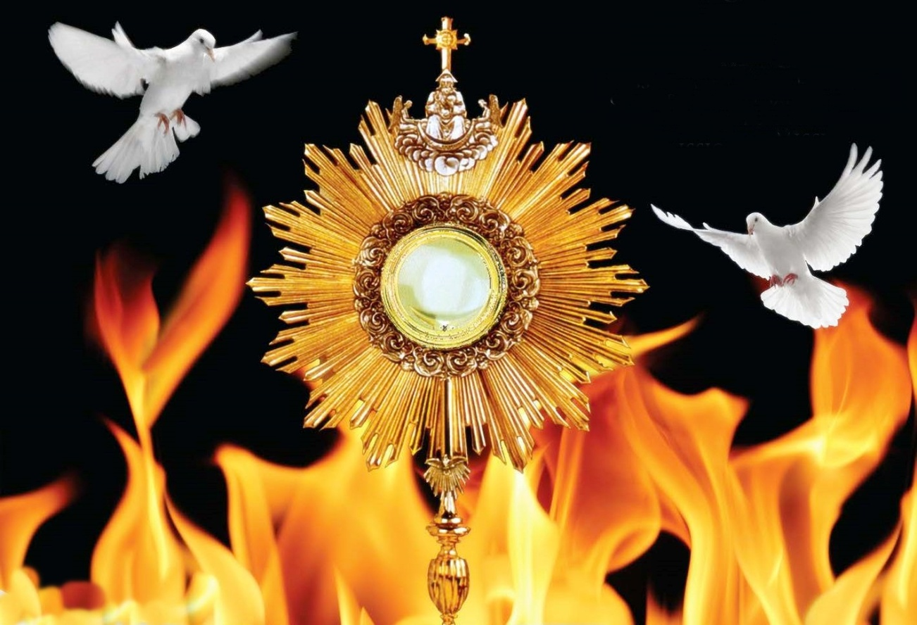
PRESENCE OF JESUS IN THE HOLY MASS
The sacrifice that Jesus offered at Golgotha is being enacted before us in the Holy mass. It is Jesus himself who offers this holy sacrifice at our altars. The whole of the Christ-mystery, from the birth of Jesus to his second coming, is being presented and experienced in the sacrament of the holy Eucharist. This is the center of Christian life.

Slide 10
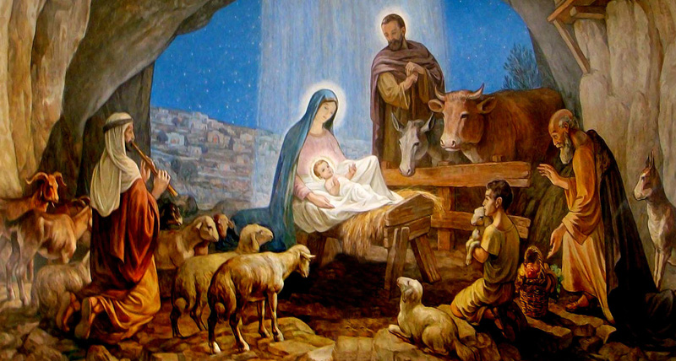
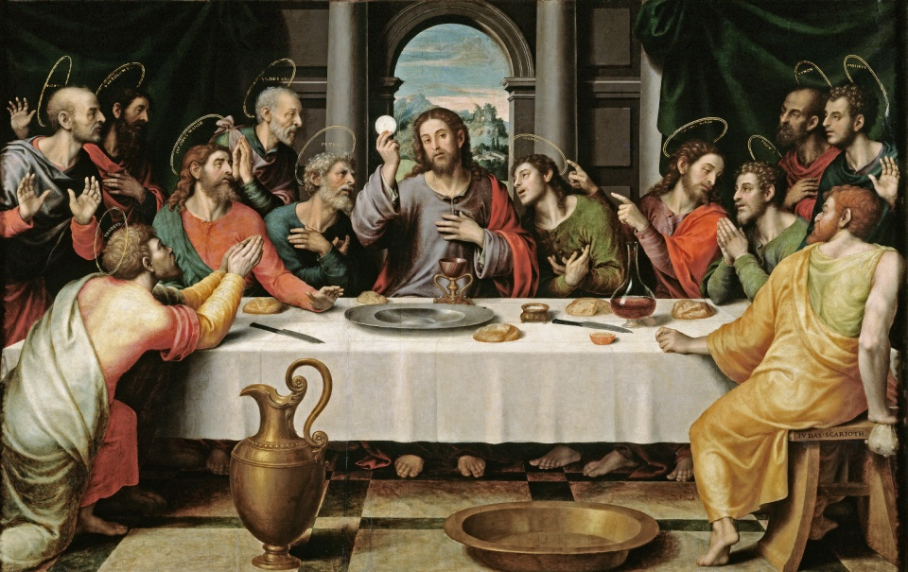
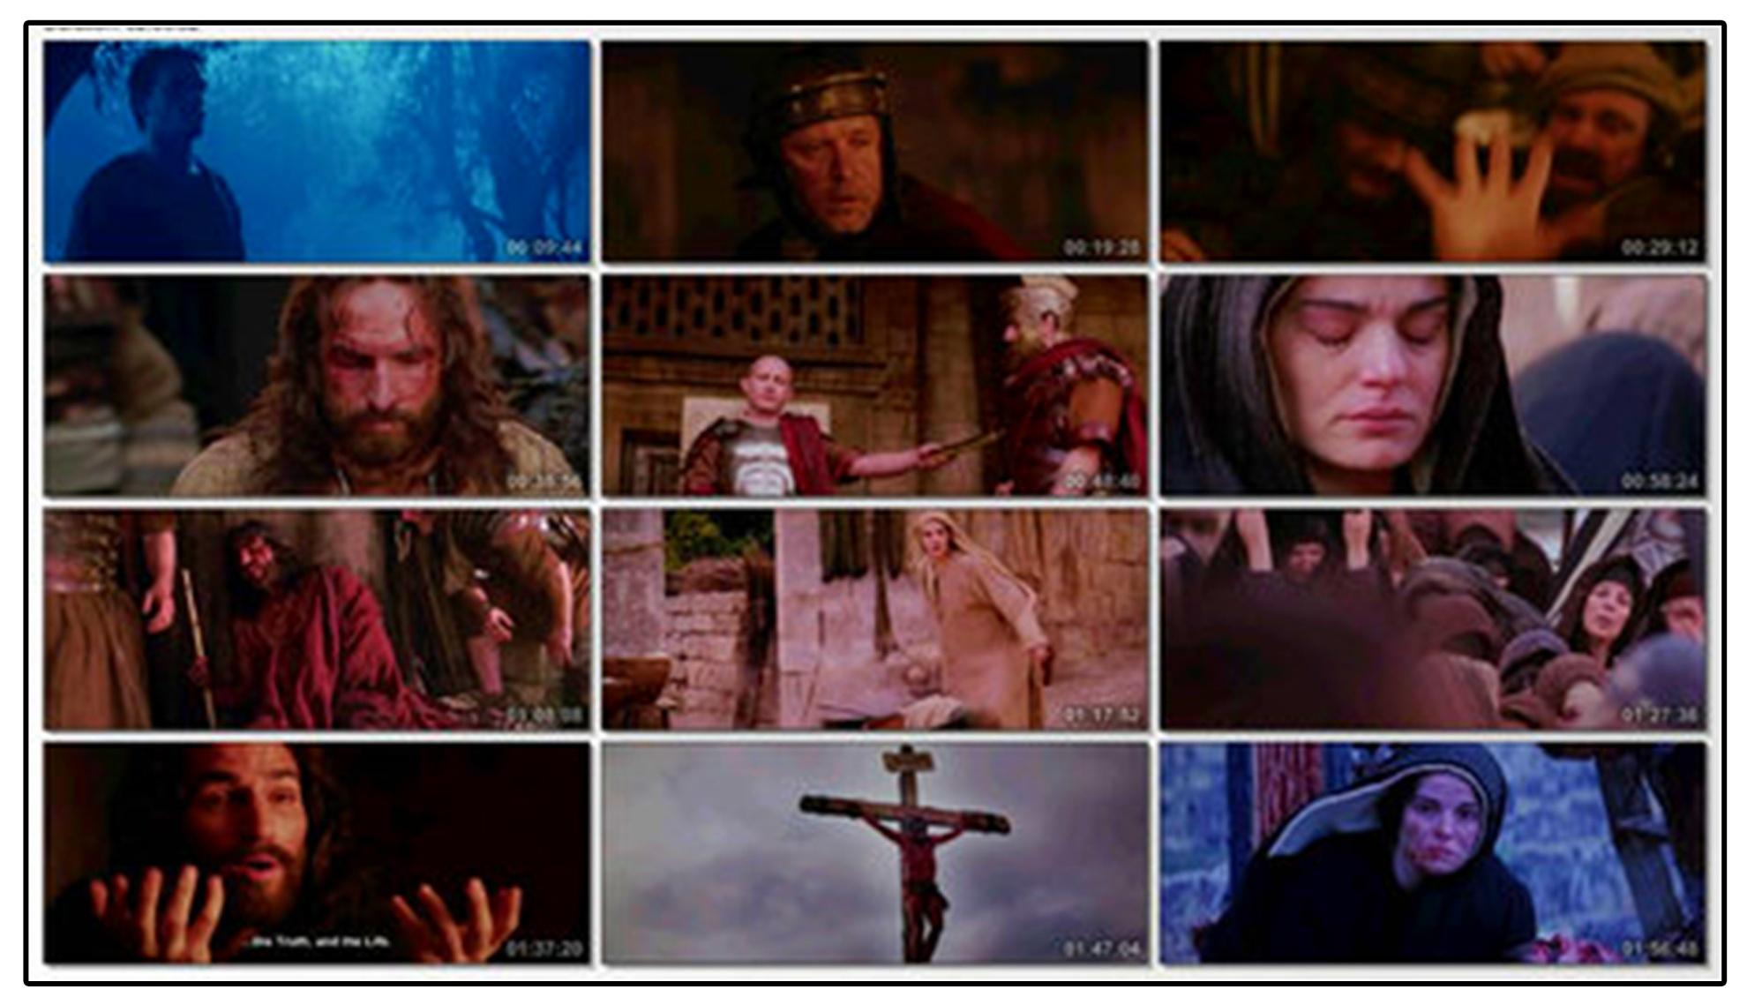

Slide 11
The Holy Mass is a sacrifice as well as a feast. Blessing us with his real presence at this feast, he offers us his body and blood as our food and drink. When Jesus broke the bread and gave it to his disciples, who were aglow with the Word, they could see Jesus in that bread. The blessed Eucharist is the bread of life. Jesus had said, “I am the bread of life” (Jn. 6: 35). “Whoever eats of this bread will live for ever; and the bread that I give for the life of the world is my flesh” (Jn. 6: 51). Jesus stays alive in the holy Eucharist. Jesus is present in the holy Eucharist totally and completely, in reality and in essence. Therefore when we approach the holy Eucharist it must be with the conviction that we are approaching Jesus himself. This Blessed Sacrament is the fulfillment of his promise; “I shall be with you till the end of the world”.
Let us live with Lord Jesus, by offering the holy Mass with reverence and devotion, and by receiving the Holy Eucharist in a worthy manner.

Slide 12
Let us pray
O! Jesus, give us the grace to participate actively in the Holy Qurbana and to receive worthily your body and blood which give us eternal life.

Slide 13
Read the word of god:
Luke 24:13-35

Slide 14
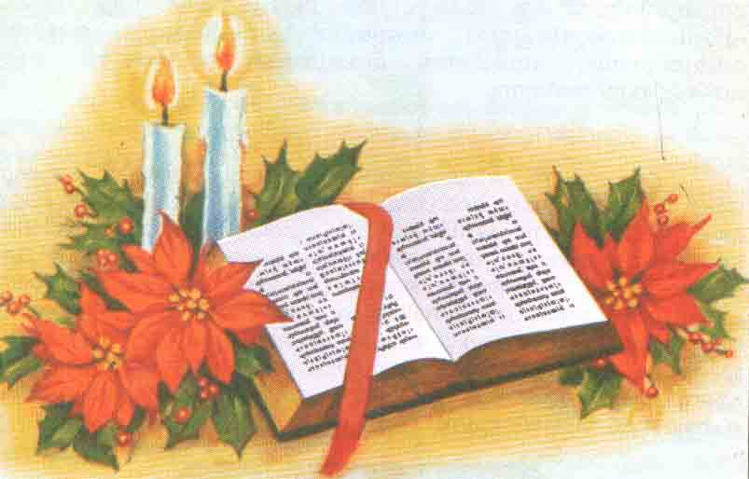
WORD OF GOD FOR GUIDANCE
"The words I have spoken to you are
spirit and life." (Jn.6:63)

Slide 15
LET US DO:
Find out write the signs Jesus used to teach about
the Holy Eucharist in the Emmaus event.

Slide 16
MY DECISION
I will try to acquire knowledge about the signs and
symbols of the Holy Qurbana to make it a
divine experience.

Slide 17
LET US Find out the answer
1. What was the subject of discussion of the disciples who went to Emmaus?
2. When were the eyes of the disciples who went to Emmaus opened?
3. What was the experience the disciples had when Jesus explained the Word of God to them?
4. What is the centre of Christian life?
5. How is Jesus present in the Holy Eucharist?

Slide 18
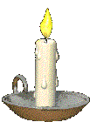


Thank you

